Slide 1
Chapter Five
REARRANGEMENT REACTION

Slide 2
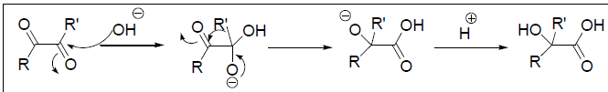
Types of Rearrangements
Rearrangements are divided into intramolecular and intermolecular processes. In intramolecular process, the group that migrates is not completely detached from the system in which rearrangement is taking place. In contrast, in intermolecular process, the migrating group is first detached and later re-attached at another site.

Slide 3
5.0 Types of Rearrangements
Rearrangements are divided into intramolecular and intermolecular processes. In intramolecular process, the group that migrates is not completely detached from the system in which rearrangement is taking place. In contrast, in intermolecular process, the migrating group is first detached and later re-attached at another site.
5.1 Rearrangement to Electron Deficient Carbon
These reactions are classified according to the nature of group that migrates.
5.1.2 Carbon Migration
5.2.1.1 Wagner-Meerwein Rearrangement
It is one of the simplest systems where an alkyl group migrates, with its bonding pair, to an electron-deficient carbon atom.

Slide 4


Wagner-Meerwein Rearrangement
Mechanism
The driving force for the rearrangement resides in the greater stability of a tertiary
carbocation compared to that of primary carbocation.

Slide 5

Cont’d
5.1.2.1 Pinacol Rearrangement
Treatment of 1,2-diols (pinacol) with acid lead to rearrangement to give ketone. Although this rearrangement fundamentally is similar to the above described Wagner-Meerwein rearrangement, but differs in that the rearranged ion, the conjugate acid of ketone, is relatively more stable than the rearranged carbocation formed in Wagner-Meerwein rearrangement. Thus, the driving force for pinacol is greater compared to Wagner- Meerwein rearrangement. However, the characteristics of the Wagner-Meerwein apply to the pinacol rearrangement.

Slide 6
Mechanism
5.1.2.3 Benzilic Acid Rearrangement
1,2-Diketones that have no  -hydrogen react with hydroxide ion to give -hydroxyacid. The best known example is the rearrangement of benzil to benzilic acid. The driving force for the reaction lies in the removel of the product by ionization of carbonyl group.

Slide 7
Cont’d
Mechanism

Slide 8
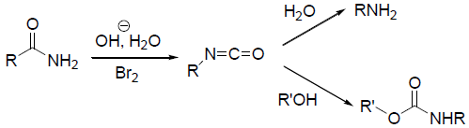
Cont’d
5.2 Rearrangement to Electron Deficient Nitrogen
5.2.1 Hofmann Rearrangement
This rearrangement provides an effective method for the synthesis of primary aliphatic and aromatic amines from primary amides (Scheme 1).
Mechanism Treatment of amide with sodium hypobromite gives N-bromo-amide which reacts with base to afford a conjugate base within which rearrangement takes place to give isocyanate. The formed isocyanate may be isolated in anhydrous conditions or it can be converted into amine by aqueous workup (Scheme 2).

Slide 9
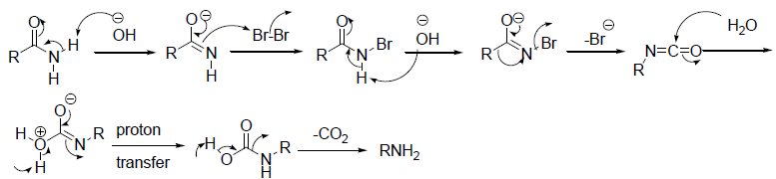

Cont’d
The workup can also be with alcohol or amine to give urethane or urea, respectively (Scheme 3).

Slide 10
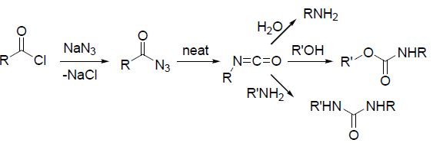
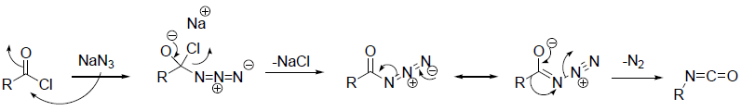
Cont’d
5.2.2 Curtius Rearrangement
This rearrangement describes the transformation of acyl azide into isocyanate by decomposition on heating and its application for the synthesis of primary amines, urethanes and ureas as presented in Hofmann rearrangement.
Mechanism

Slide 11

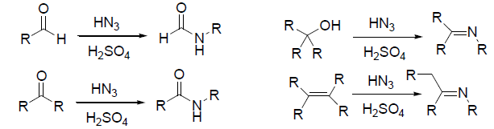
Cont’d
5.2.3 Schmidt Rearrangement
Carboxylic acid reacts with hydrazoic acid in the presence of conc. H2SO4 to give acid azide which is present in the form of conjugate acid eliminates nitrogen to afford isocyanate that could be converted into amine as reported in Hofmann rearrangement.
The reaction is also effective with aldehydes, ketones, tertiary alcohols and substituted alkenes.

Slide 12
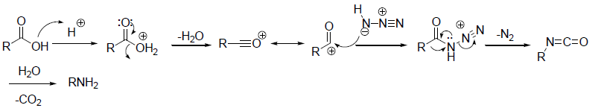
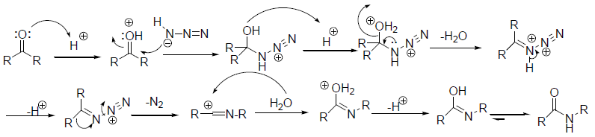
Cont’d
Mechanism

Slide 13
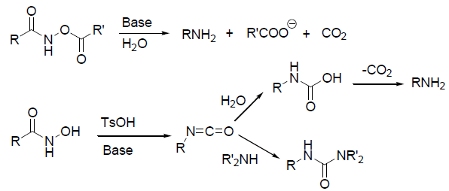
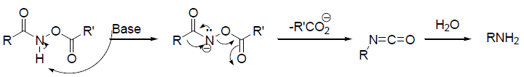
Cont’d
5.2.4 Lossen Rearrangement
Ester of hydroxamic acid reacts with base to give isocyanate that could be converted into amine as shown in Hofmann rearrangement.
Mechanism

Slide 14

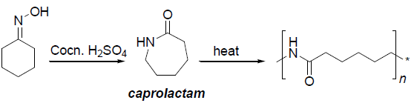
Cont’d
5.2.5 Beckmann Rearrangement
Oximes rearranges in acidic conditions to give amides. The reaction is intramolecular and stereospecific: the substituent trans to the leaving groups migrates.
An interesting application of this method is the synthesis caprolactam from cyclohexanone oxime. Caprolactam is the substrate precursor for nylon preparation.

Slide 15
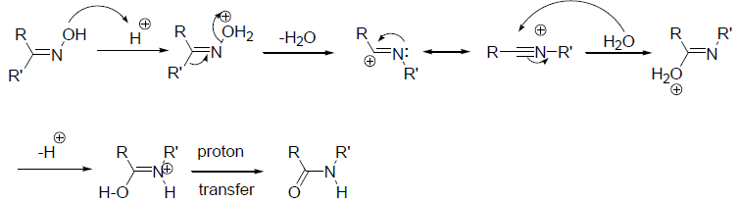
Cont’d
Mechanism

Slide 16
Rearrangement to Electron Deficient Oxygen
5.3 Rearrangement to Electron Deficient Oxygen
Reading Assignment

